Slide 1
PHASE II Washington/Jefferson Avenues Drainage Improvement Project
A Project to Improve the Lives of ALL RESIDENTS in the City of Grants
Early Floodplain Review Public Hearing | September 3, 2020
Presented by the City of Grants, NWNMCOG & Wilson & Co.
City of Grants, NM

Slide 2
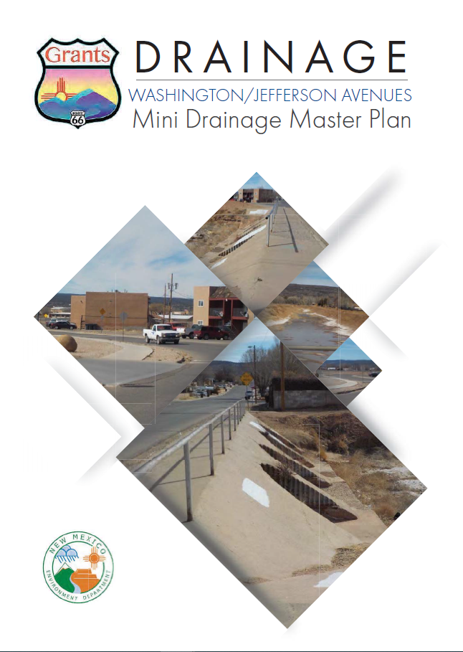
BACKGROUND
The City is applying for Community Development Block Grant (CDBG) funding to improve drainage infrastructure on Washington Avenue.
Project(s) stem from the 2011 Drainage Master Plan
Preliminary Engineering Report – Completed 2018 Mini Drainage Master Plan
The project is the second phase of the larger Washington/Jefferson Avenues Drainage Improvements Project
To pitch a shovel ready project, the City has opted to initiate Environmental Review activities prior to award. This meeting is a required activity based on the project’s location in a designated FEMA floodplain.

Slide 3
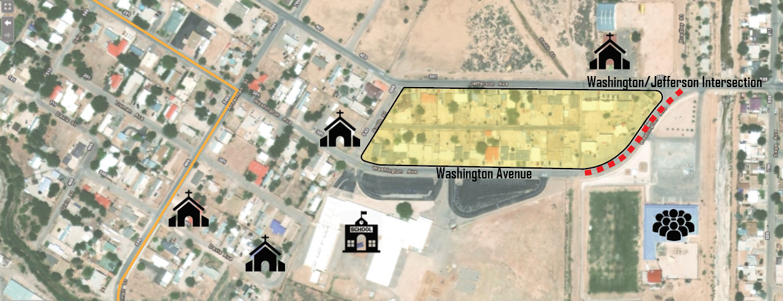
PROJECT OVERVIEW
Project Description
Construction: 450-LF (approximately 1 city block) Full depth street reconstruction including new underground storm drainpipe, street inlets, hot mix asphalt paving, curb & gutter, concrete drive pads, and utility conflict relocations.
Construction Management: pre-construction and construction related activities, including but not limited to, letting and bidding, bid opening, pre-construction meetings, daily observations, substantial and final construction close-out and acceptance.
Washington Ave. (Approximately 450 linear feet) – Project Termini
Mesa View Elementary (Approximately 460 Students Enrolled)
Future Foundations Family Center (Utilized by All Residents of City & County)
Dwelling Units Directly Impacted (52 of 75 Impacted)
Religious Institutions (Total of 4 in the Immediate Vicinity of Project Site)

Slide 4
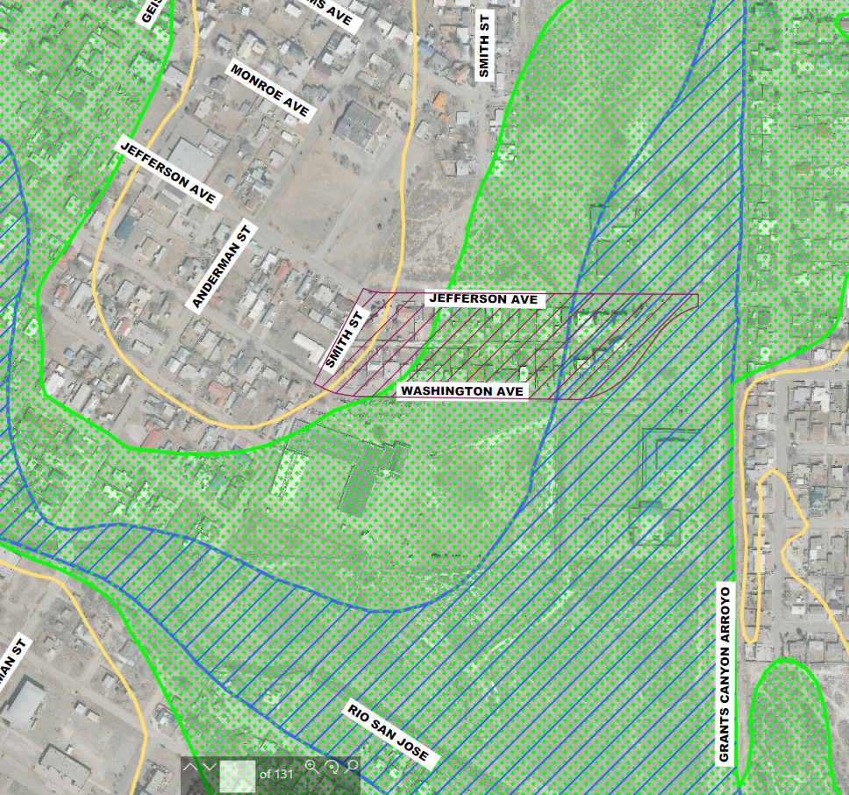
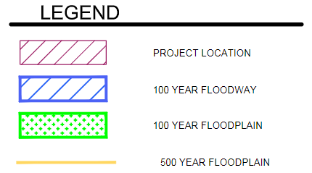
FLOODPLAIN MAP
The Proposed Project is in a 100-yr Floodplain/Floodway
1% or greater chance of shallow flooding each year, usually with a depth ranging from 1ft – 3ft.

Slide 5
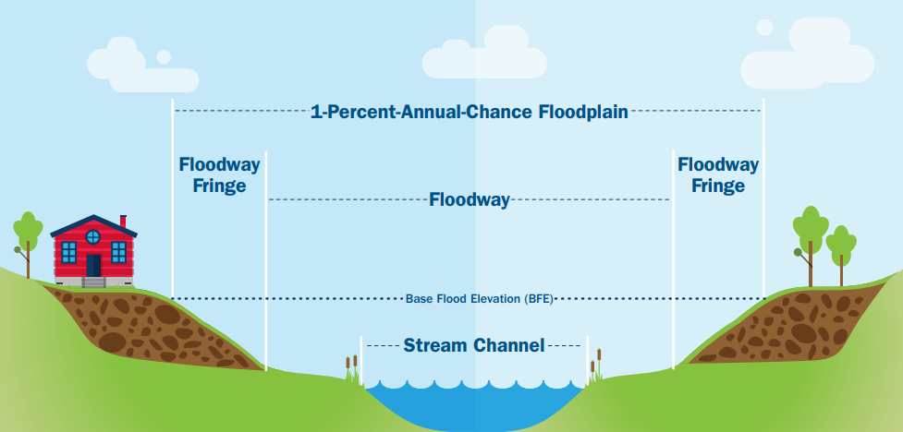
FLOODPLAIN VS FLOODWAY
Floodplain: is comprised of the floodway and the floodway fringe. The floodway includes the channel and adjacent overbank areas necessary to effectively convey floodwaters.
Floodway: is the primary conveyance area of a channel’s cross-section that is the natural conduit for floodwaters. The floodway must remain open in order to allow flood waters to pass.

Slide 6
PURPOSE OF MEETING
Identification and evaluation of practicable alternatives
Alternatives to be considered include:
Carrying out the proposed activity at a location outside the base floodplain
Other means of accomplishing the same purpose as the proposed activity
No action
Identify adverse impacts of the proposed activity
Positive and Negative Impacts
Concentrated and dispersed impacts
Short and long-term impacts

Slide 7
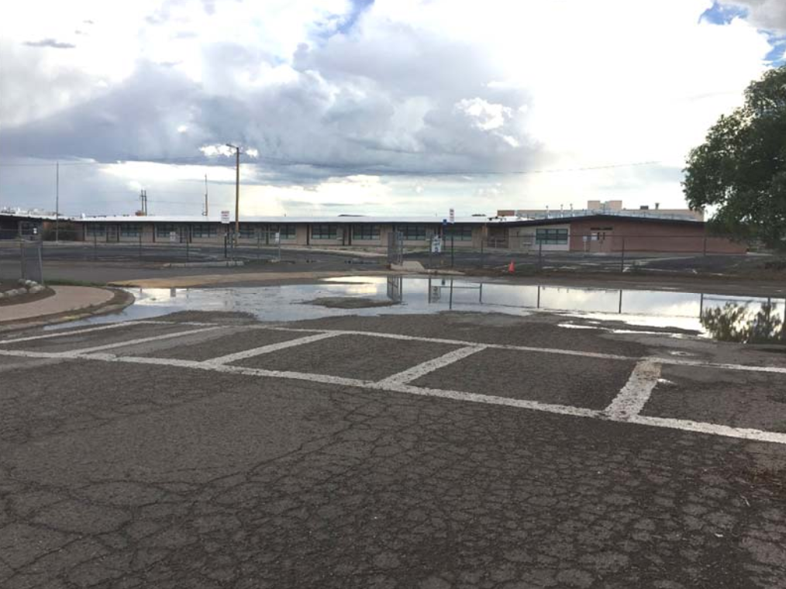
PURPOSE OF MEETING
Inform the Public about the Proposed Project Impacts to the FEMA Floodplain
Wilson & Company’s determination that construction will be compatible with the floodplain areas and will not encroach on the floodplain or floodway such that flood heights are substantially elevated
Will not affect the quality of the human environment

Slide 8
COMMENTS CAN BE SENT TO: Brandon Howe, Planner Northwest New Mexico Council of Governments 106 West Aztec Avenue Gallup, NM 87301 bhowe@nwnmcog.org or Donald Jaramillo, Special Projects Coordinator City of Grants 523 W. Santa Fe Avenue Grants, NM 87020 projects@grantsnm.gov
Phase II – Washington/Jefferson Avenues Drainage Improvement Project
Deadline for Comments is:
September 11, 2020

Slide 9
THE CITY OF GRANTS THANKS YOU FOR CONSIDERATION OF OUR PROJECT!
Phase II – Washington/Jefferson Avenues Drainage Improvement Project
Contact Information: Laura Jaramillo, City Manager manager@grantsnm.ngov

